Slide 1
REVELATION

Slide 2
REVELATION
Apokalupsis – unveiling

Slide 3
REVELATION
Views on the Millennium:
Amillennialism ~ Belief there will be a continuous parallel of good and evil in the world between the 1st and 2nd
Coming of Christ. The
Kingdom of God is now
present in the world
through the Word, His
Spirit and His Church.

Slide 4
REVELATION
Views on the Millennium:
Postmillennialism ~ Belief the Kingdom of God is now extended through teaching, preach-
ing and evangelism. The
world is to be Christian-
ized resulting in a long
period of peace and
prosperity, followed by
Christ’s return.

Slide 5
REVELATION
Views on the Millennium:
Premillennialism ~ Belief in the concept of two-stages in the Coming of Christ. He will
come for His Church
(Rapture) and then with
His Church (Revelation).
There is a consistent
distinction between
Israel and the Church throughout history.

Slide 6
REVELATION
Different interpretations of the Book of Revelation:
Preterist ~ (Amillennial) — the belief that there is no
literal millennial reign of
Christ on earth

Slide 7
REVELATION
Different interpretations of the Book of Revelation:
Historical ~ (Postmillennial) — the belief that Christ will
return at the end of the millennial age

Slide 8
REVELATION
Different interpretations of the Book of Revelation:
Idealist ~ (Amillennial) — the belief that there is no
literal millennial reign
of Christ on earth

Slide 9
REVELATION
Different interpretations of the Book of Revelation:
Futuristic~ (Premillennial) — the belief that Christ will
return to usher in the
millennial age

Slide 10
REVELATION
Write the things which you have seen, and the things which are, and the things which will take place after this.
Which you have seen ~ 1
Which are ~ 2-3
Which will take place after this ~ 4-22
Revelation 1.19

Slide 11
REVELATION
After these things ~ meta tauta – 10x
1.19; 4.1 (2x); 7.1; 7.9; 9.12; 15.5; 18.1; 19.1; 20.3

Slide 12
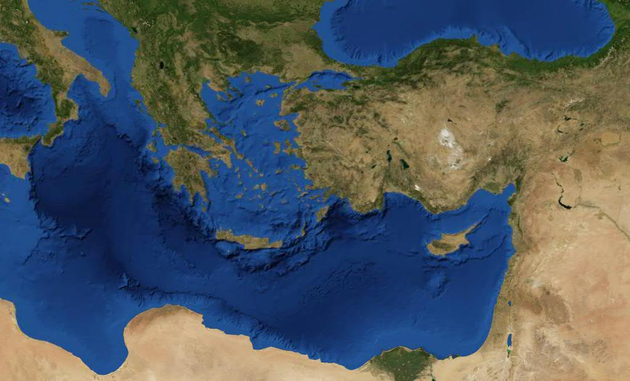
REVELATION
Pergamos
Thyatira
Sardis
Laodicea
Smyrna
Philadelphia
Ephesus

Slide 13
24 Elders
(5)
REVELATION
Ephesus
Smyrna
Pergamos
Thyatira
Sardis
Philadelphia
Laodicea
Church
Ref.
Date
Representation
AD 33 -100
2.1-7
Apostolic Church
AD 100 -314
Persecution Church
2.8-11
2.12-17
AD 314 -590
Pagan Church
2.18-29
AD 590 - Present
Roman Church
3.1-6
AD 1517 - Present
Reformation Church
3.7-13
AD 1800 - Present
Revived Church
3.14-22
AD 1800 - Present
Relaxed Church

Slide 14
24 Elders
(5)
REVELATION
Meta tauta
After these things
I looked, and behold, a door standing open in heaven. And the first voice which I heard was like a trumpet speaking with me, saying,
"Come up here, and I will
show you things which must
take place
meta tauta."
after this."
Revelation 4.1

Slide 15
24 Elders
(5)
REVELATION
The
Rapture (4)
5
10
15
20
24 Elders (5)
"Church" is mentioned 19x in (1-3)
"Church" is not mentioned in (6-18)

Slide 16
24 Elders
(5)
REVELATION
⁹ And they sang a new song, saying: "You are worthy to take the scroll, And to open its seals; For You were slain, And have redeemed us
to God by Your blood Out of
every tribe and tongue and
people and nation, ¹⁰ And have
made us kings and priests to
our God; And we shall
reign on the earth."
Revelation 5.10-11

Slide 17
24 Elders
(5)
REVELATION
¹⁶ For the Lord Himself will descend from heaven with a shout, with the voice of an archangel, and with the trumpet of God. And the dead in Christ will rise first. ¹⁷ Then
we who are alive and remain
shall be caught up together with
them in the clouds to meet the
Lord in the air. And thus we
shall always be with the Lord.
Shall be caught up ~ harpazō
LXX ~ rapio
1 Thessalonians 4.16-17

Slide 18
REVELATION
24 Elders
(5)
Millennium
(20)
New Heavens/
New Earth (21-22)
5
10
15
20
7 Bowls
(16)
7 Seals
(6-8)
Mark of the Beast
(13)
7 churches
(2-3)
7 Trumpets
(8-11)
The
Rapture
(4)

Slide 19
24 Elders
(5)
REVELATION
1
2
3
4
5
6
7
Seals
Plague
Comparison
Trumpets
Bowls
Hail, fire & blood
Loathsome soars
Antichrist
The Earth
War
1/3 water to blood
Sea to blood
The Sea
Famine
Bitter water
Fresh water to blood
The Rivers
Death
1/3 sun, moon & stars
Scorched earth
The Heavens
Martyrdom
Mankind
Locusts
Darkness
Army/
Euphrates
Euphrates dried up
Cataclysm
War
Second Coming
Jesus takes over
"It is done!"
Interlude

Slide 20
REVELATION
7 yr.
Rapture
2nd Coming
Magog?
7th Seal
7th Trumpet
7th Bowl
Rise of Antichrist; time of relative peace in Israel
Trumpets 1-6
Bowls 1-6
Seals 1-6

Slide 21
REVELATION
Come ~ middle voice, passive tense
Literally ~ "are still arriving from the tribulation, the
great one"

